Slide 1
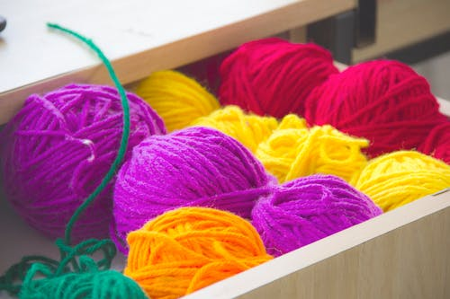
CHALLNEY HIGH SCHOOL FOR GIRLS COMMUNITY KNITTING PROJECT
Research has shown that knitting could reduce depression and anxiety, slow the onset of dementia, distract from chronic pain, and increase overall sense of wellbeing. One study found that the act of knitting lowers heart rate by an average of 11 beats per minute, signifying a sizeable increase in relaxation.

Slide 2
WHAT DO I NEED?
PAIR OF 4.5MM KNITTING OR 4MM NEEDLES
DOUBLE KNITTING WOOL
40 stitches on 4.5mm needles to make a 20cm square
50 stitches on 4mm needles to make a 20cm square

Slide 3
https://www.youtube.com/watch?v=p_R1UDsNOMk
https://www.youtube.com/watch?v=oh1SIfTpm-0
HOW CAN I GET STARTED?
Watch the following instructional video
https://www.youtube.com/watch?v=p_R1UDsNOMk
ANY QUESTIONS PLEASE SEND AN EMAIL TO Mrs Potter
spotter@challneygirls.luton.sch.uk

Slide 4
STITCH TENSION/NEEDLE SIZES
DEPENDING ON HOW TIGHT/LOOSE YOU KNIT, YOU MAY NEED TO ADJUST THE AMOUNT OF STITCHES YOU USE TO MAKE A 20CM X 20CM SQUARE.
4.5MM (UK SIZE 7) NEEDLES YOU MAY NEED BETWEEN 35-40 STITCHES DEPENDING ON YOUR TENSION.
4 MM (UK SIZE 8) YOU MAY NEED BETWEEN 45-50 STITCHES DEPENDING ON YOUR TENSION
4.00mm | UK | 8
4.50mm | UK | 7

